Slide 1
Introduction
OpenCelliD – BigData Presentation
Student: Mobin Idrees
Supervisor: Dr. Frederic Stahl

Slide 2
OpenCelliD is BigData collection of Cell Towers and WiFi Aps. This database is built by the community and is free available for download. The row count is 39,374,666, Last updated on : 2018-02-14 Database link in CSV format https://opencellid.org/downloads

Slide 3
Database

Slide 4
Data Base Structure
Field | Description (based on official documentation where available)
ID | This field is auto Incremented.
Radio | UMTS/ GSM /LTE
Area | Location Area Code
Cell | Cell ID represents the ID of Cell for which you want to display the data.
Range | Estimated Range of the cell in meters
Samples | Total number of readings taken from that cell tower
Latitude | GPS latitude of the measurement
Longitude | GPS longitude of the measurement
Mcc | Mobile Country Code
Mnc | Mobile Network Code
Created | Date the Cell tower was added
Updated | Date the Measurement is Updated

Slide 5
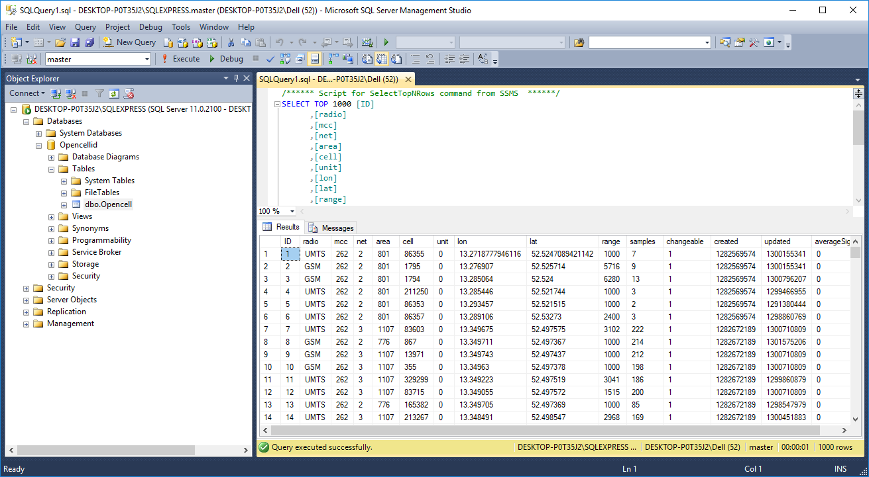
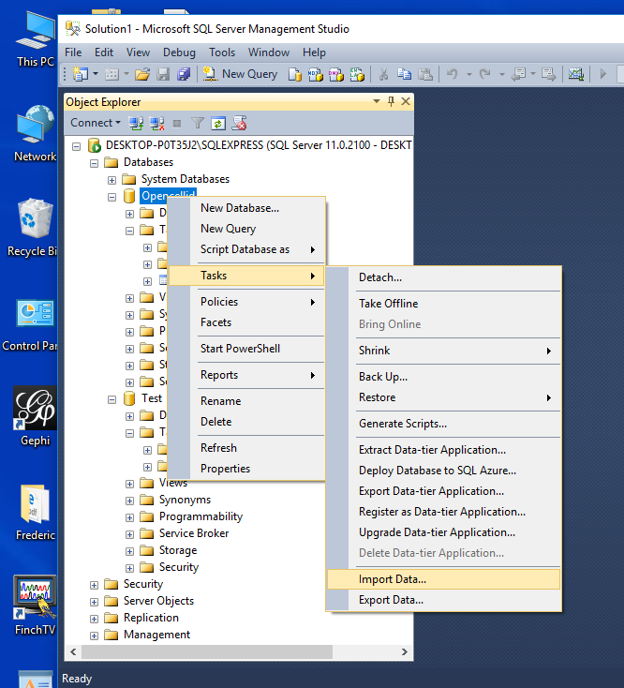
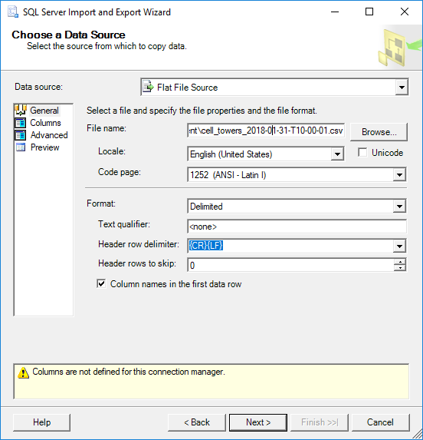
Import CSV in SQL Server
Import
Configuration
Query

Slide 6
Application
Source Code available at : https://github.com/mimm1/OpenCell

Slide 7
The Application provides a simple interface for requesting geo-registered map images from one or more distributed geospatial databases.
The interface is developed in Visual Studio and Model-View-Controller is used to create interfaces. The map is integrated in the application using Asynchronous JavaScript and XML (AJAX) and the JavaScript Object Notation (JSON) format has been used to serialize and transmit the structured data.
A utility library has been created to interact with Bing Maps to display a map with location markers. The feature is added to determine the geographic location of the users from their IP addresses.
The geospatial features of SQL Server are implemented to perform a location-based radius search. The overlay objects are tied to the latitude and longitude coordinates to display markers and relevant information on the map.

Slide 8
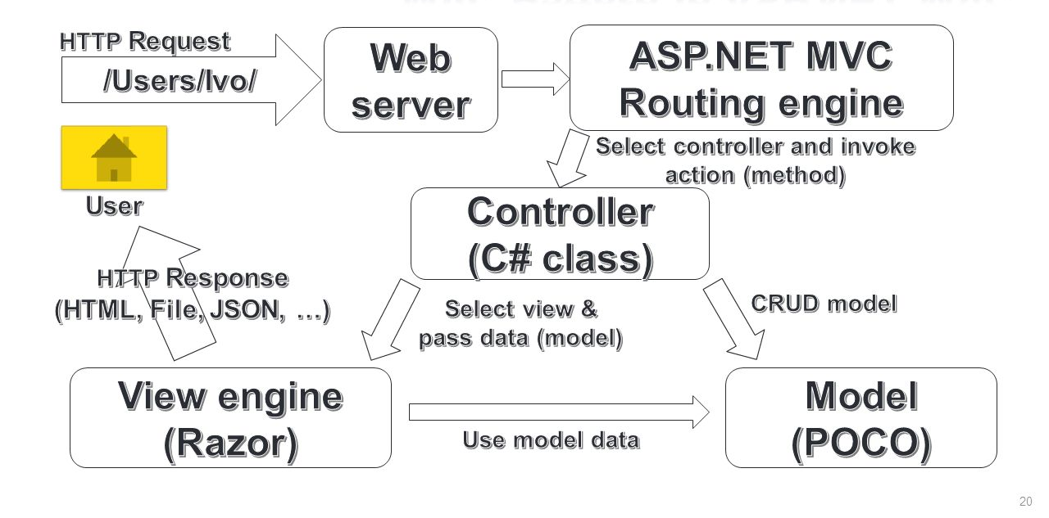
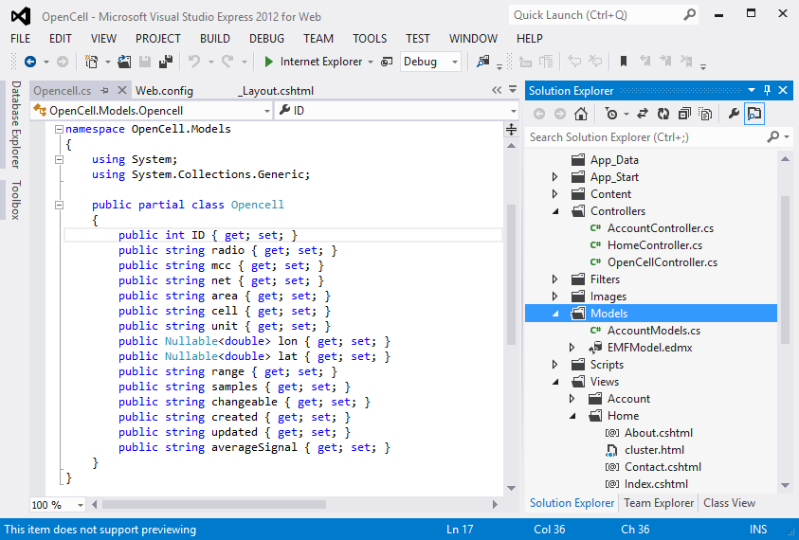
Model View Controller (MVC)
Controllers
Model
View
OpenCell Class

Slide 9
The OpenCell view in the Razor view engine and the strongly-typed view is selected for the model class. The scaffold template is used for creating list, details, edit, and delete views based on the master layout.
The related information is stored in the database and passed to the map and appears on the info window on the Mouse Click event on the Markers. The geographic locations of OpenCell towers are stored in the SQL table with latitude and longitude values received from the maps.
Partial views are used to create, edit, or view the geographic locations of the Cell towers. The mapping functionality is utilized in several places within the application; therefore a shared Map functionality has been utilized within a single partial template to reuse in multiple controllers and views. The callback event handler function is used; this adds a pin to the map for location identification. Draggable pushpins are used on the map for location identification of Cell towers.

Slide 10
Bing MAP V8 API
Shared -> _Layout.cshtml
<script type='text/javascript' src='https://www.bing.com/api/maps/mapcontrol?branch=experimental&key=KeyHere& callback=onMapLoaded' async defer></script>
Callback function
Bing Maps V8 API
Required for clustering
function onMapLoaded() {
var map = new Microsoft.Maps.Map(document.getElementById('theMap'), {
/* No need to set credentials if already passed in URL */
center: new Microsoft.Maps.Location(39.393486, -98.100769),
zoom: 3 });
Microsoft.Maps.loadModule('Microsoft.Maps.Clustering', function () {
// Creating sample Pushpin data within map view
var pins = [];
@foreach (var item in Model) {
<text>
var pin = new Microsoft.Maps.Pushpin(new Microsoft.Maps.Location(@item.lat, @item.lon));
pin.metedata = item;
pins.push(pin);
</text>
}
//var pushpins = Microsoft.Maps.TestDataGenerator.getPushpins(1000, map.getBounds());
var clusterLayer = new Microsoft.Maps.ClusterLayer(pins, { gridSize: 100 });
map.layers.insert(clusterLayer);
});
}
View -> _Index.cshtml
Loop to generate dynamic pins from the database
Call Clustering Function

Slide 11
The application is created in ASP.NET C# using Visual Studio and SQL Server. The Model-View-Controller Version 4 is used to enable desktop and mobile views.
The Razor is used as a view engine because its syntax is compact and reduces typing.
The controllers are created employing a scaffolding template "read, write, actions, and views" using Razor view and the OpenCell. The controller is responsible for controlling how a user interacts with an MVC application.
Entity Framework (EF) approach applied as the database was already created using OpenCell CSV file, when the database is already created, the EF automatically generates a data model that consists of classes and properties

Slide 12
OpenCell.js
MAP Function Scripts
OpenCell.LoadMap = function (latitude, longitude, onMapLoaded) {
OpenCell._map = new Microsoft.Maps.Map(document.getElementById('theMap'), {});
// Create draggable Pin in the center
var center = OpenCell._map.getCenter();
var Location = Microsoft.Maps.Location;
var Pushpin = Microsoft.Maps.Pushpin;
if (latitude != null && longitude != null) {
this._map.setView({
center: new Microsoft.Maps.Location(latitude, longitude),
zoom: 15
});
OpenCell._pins = new Pushpin(new Location(latitude, longitude), { color: '#00f', draggable: true });
}
else {
OpenCell._pins = new Pushpin(new Location(center.latitude, center.longitude), { color: '#00f', draggable: true });
}
OpenCell._map.entities.push(OpenCell._pins);
// Binding the events
OpenCell.EnableCallback();
}
OpenCell.LoadPins = function (latitude, longitude) {
OpenCell._map = new Microsoft.Maps.Map(document.getElementById('theMap'), {});
// Create draggable Pin in the center
var center = OpenCell._map.getCenter();
var Location = Microsoft.Maps.Location;
var Pushpin = Microsoft.Maps.Pushpin;
if (latitude != null && longitude != null) {
this._map.setView({
center: new Microsoft.Maps.Location(latitude, longitude),
zoom: 15
});
OpenCell._pins = new Pushpin(new Location(latitude, longitude), { color: '#00f', draggable: false });
}
else {
OpenCell._pins = new Pushpin(new Location(center.latitude, center.longitude), { color: '#00f', draggable: false });
}
OpenCell._map.entities.push(OpenCell._pins);
// Binding the events
//OpenCell.EnableCallback();
}
Events Handlers
OpenCell.EnableCallback = function () {
var Events = Microsoft.Maps.Events;
Events.addHandler(OpenCell._pins, 'drag', function (e) { onMouseUp(e); });
}
function onMouseUp(e) {
var loc = e.location;
$("#lat").val(loc.latitude.toString());
$("#lon").val(loc.longitude.toString());
}

Slide 13
Runtime

Slide 14
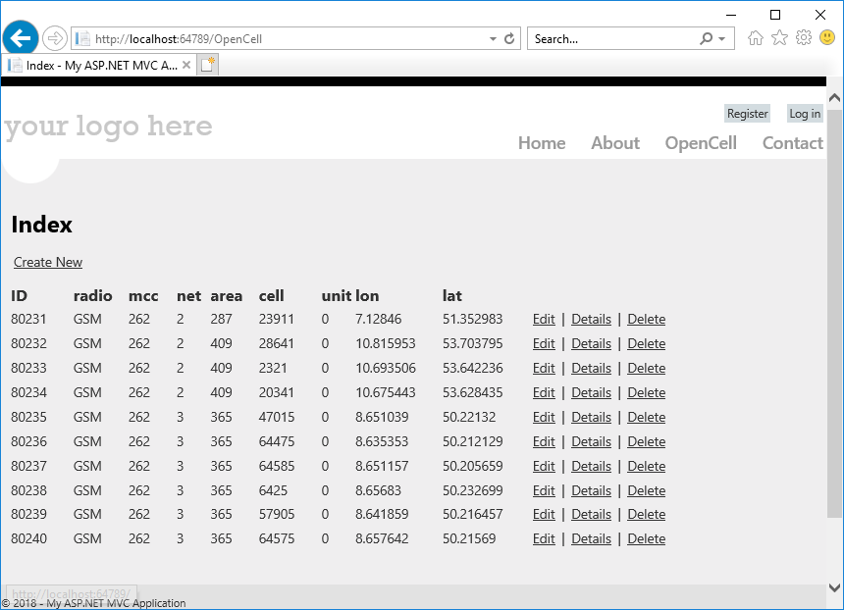
CRUD Functionality
List top 10 rows
OpenCell.Controllers
public ActionResult Index()
{
return View(db.Opencells.Where(x=>x.ID<=10).ToList());
}

Slide 15
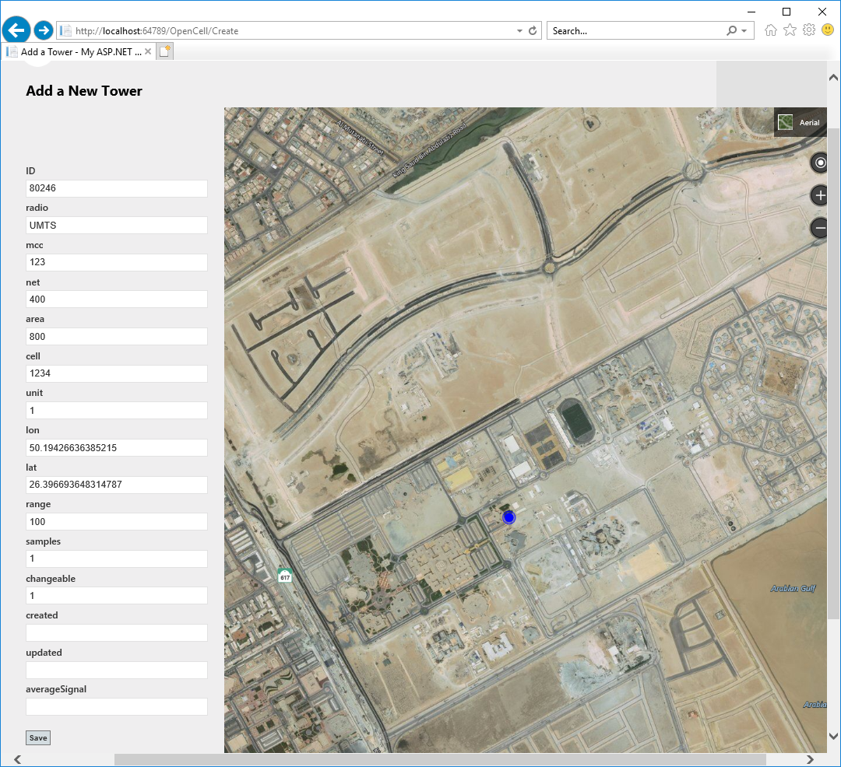
Create New
Dragging of Pin Auto updates Longitude and Latitude
New Draggable Pin
Save New Tower ID “80246”
In Database

Slide 16
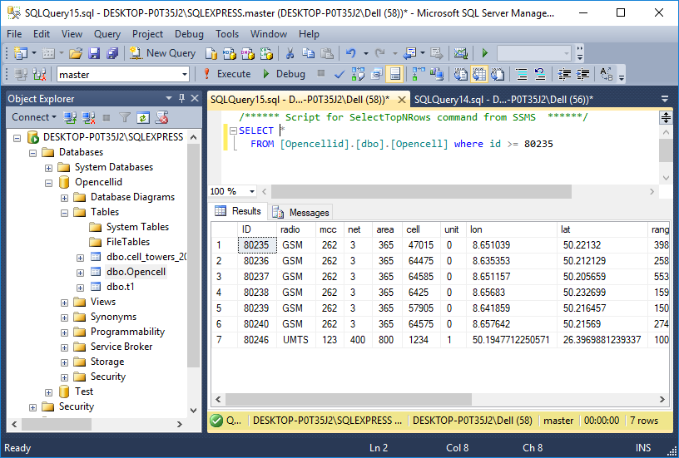
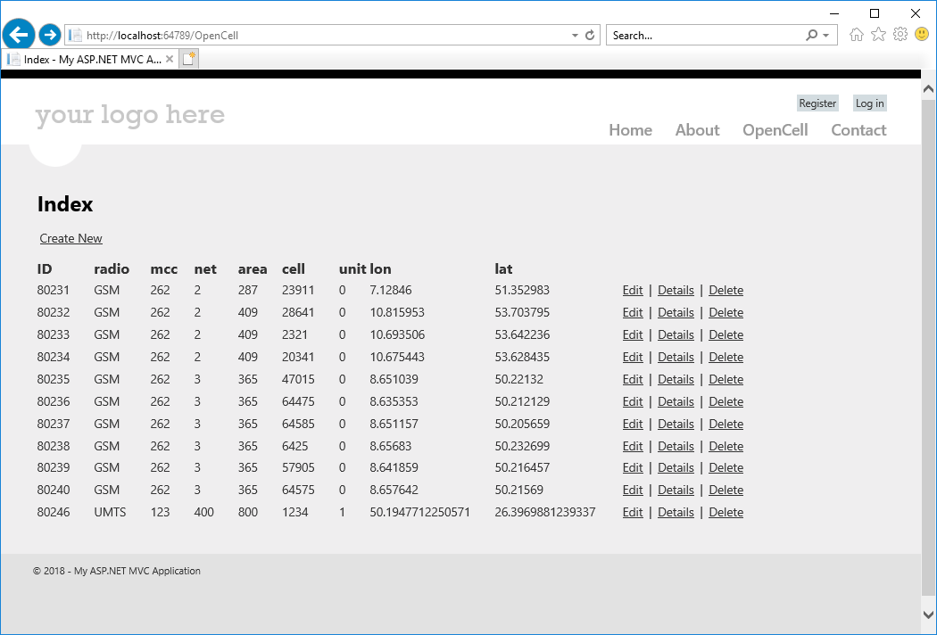
Locate New ID
New ID “80246”
In the Database
New ID “80246”
In the View

Slide 17
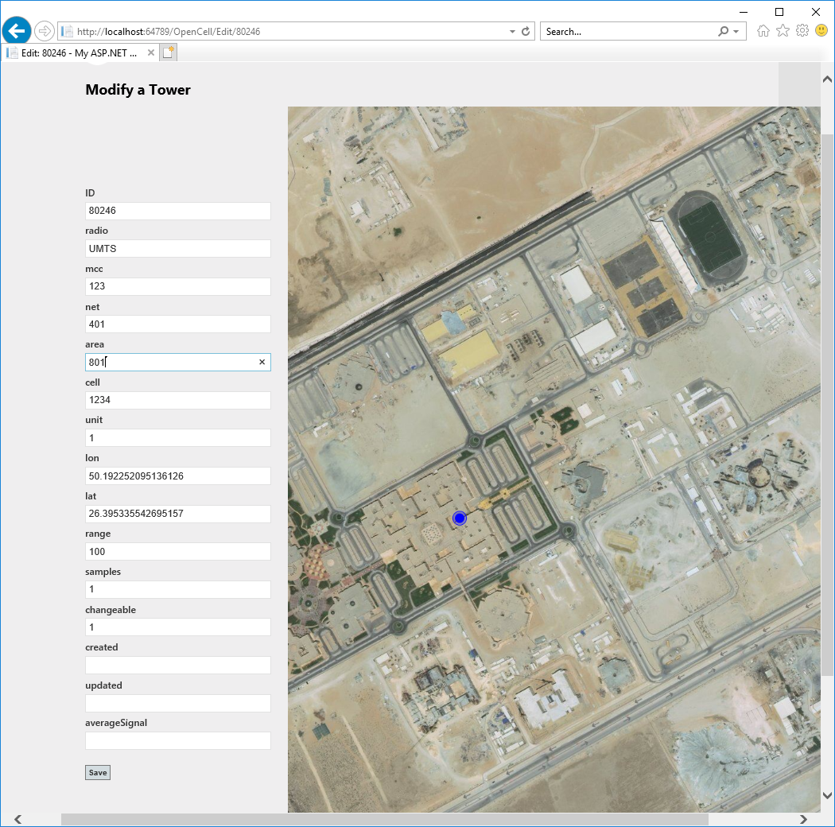
Modify the Location
Load Tower ID “80246”
From the Database
Drag the Pin to new Location to update new location
Update Tower ID “80246”
In the Database

Slide 18
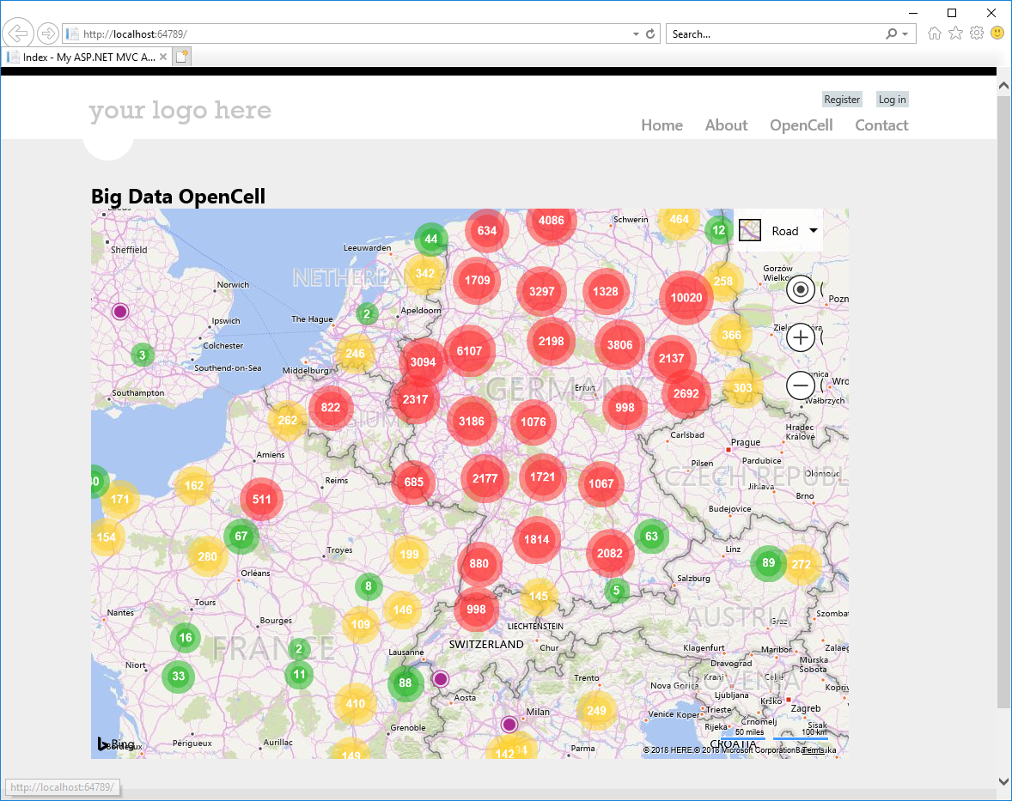
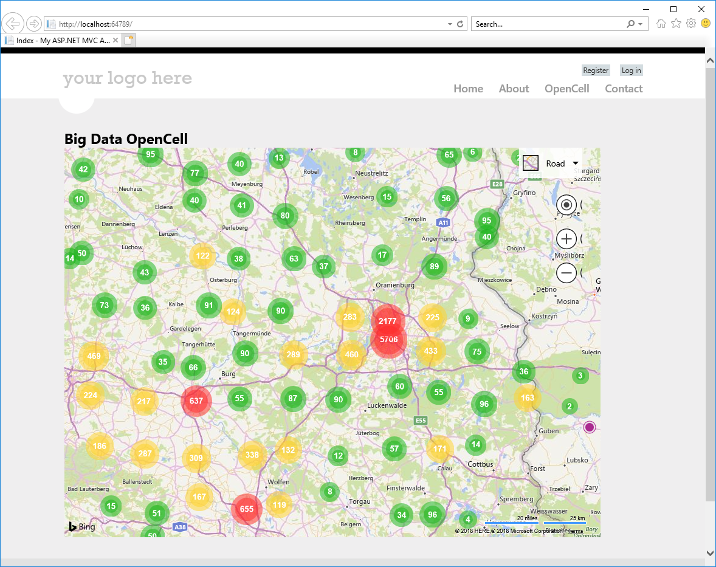
Germany : Largest cluster size “10020”
‘Oranienburg’ region
Largest cluster size “5706”
Germany Zoom Level : 4
Germany Zoom Level : 6

Slide 19
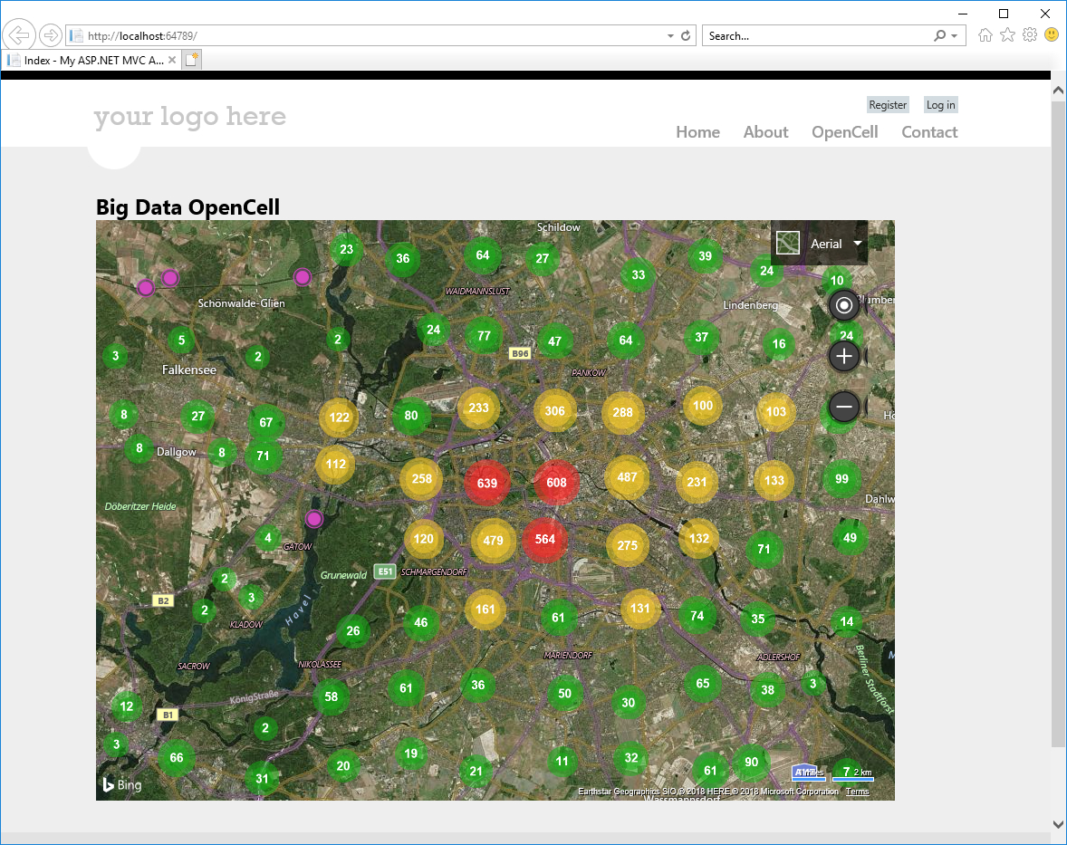
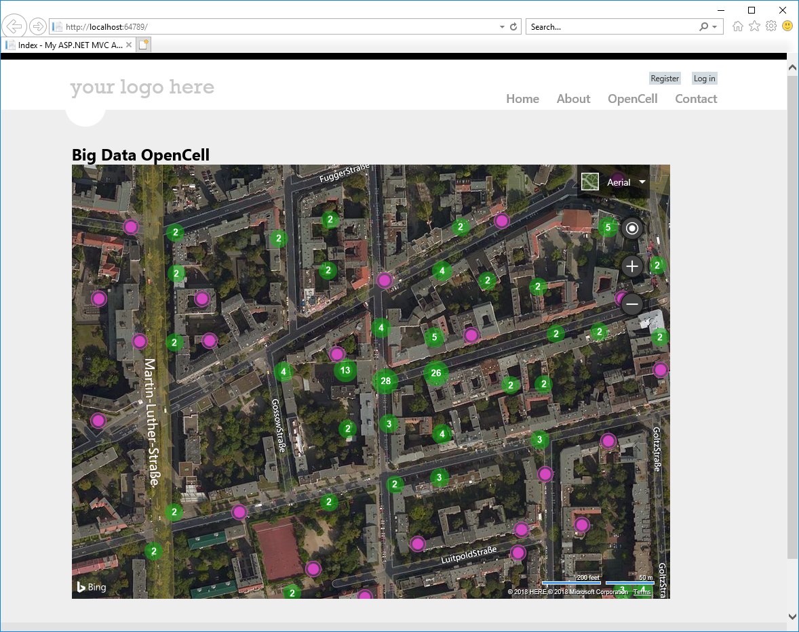
Dense Cluster in Wilmersdorf Area
Dense Cluster in Eisenacher StraBe “28” Measurements
Street View
City View

Slide 20
Thanks

